Slide 1




+
=

Slide 2
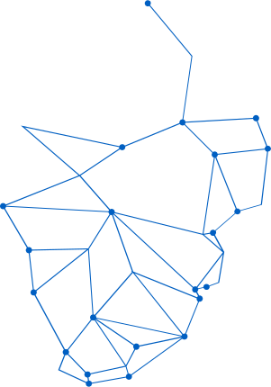
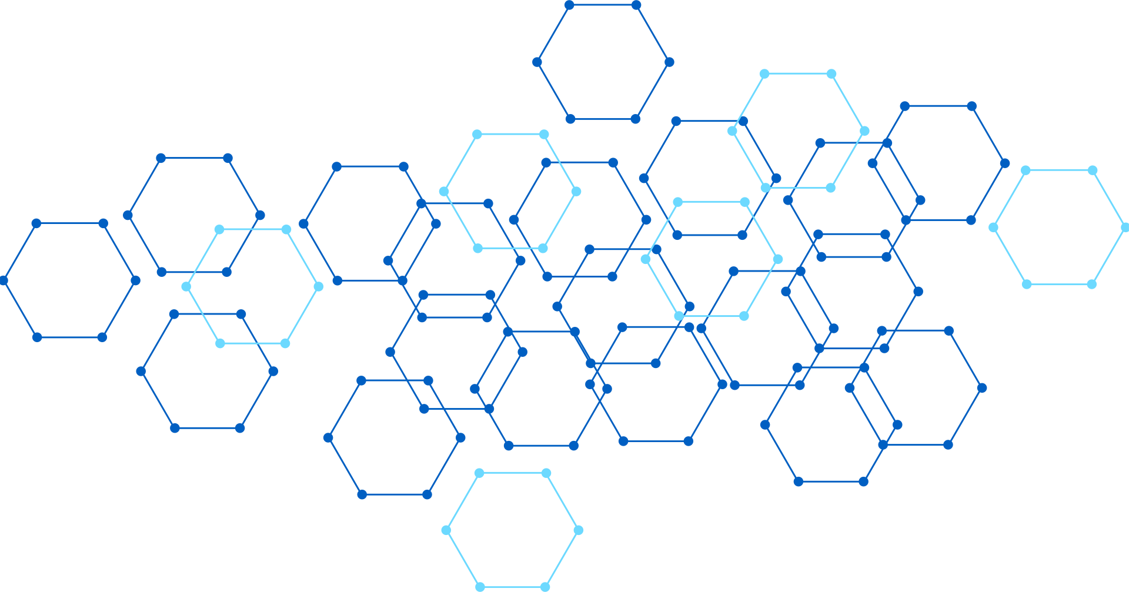
KUBERNETES STORAGE & MONITORING
Docker Volumes, PV, PVC, Storage Classes, Prometheus & Grafana

Slide 3
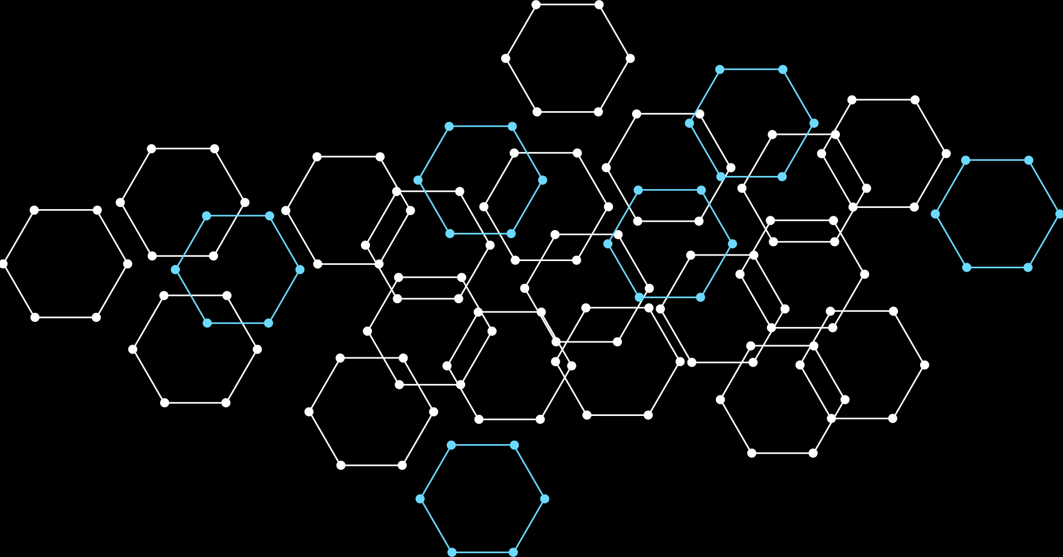


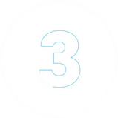
SESSION AGENDA
YAML & Storage Concepts
Understanding YAML fundamentals, what volumes are, why we need persistent storage, and the Kubernetes storage architecture overview.
Volume Types & Architecture
Exploring emptyDir, hostPath, ConfigMap, Secrets, NFS, and CSI Storage - understanding when and how to use each type.
Live Demo with Monitoring
Hands-on demonstrations showing volume behaviors, limitations, and solutions with Prometheus & Grafana integration.

Slide 4

INTRODUCTION
Why This KT Matters: Understanding Kubernetes storage concepts is essential for deploying stateful applications. Volumes, PVs, PVCs, and Storage Classes form the foundation of persistent data management in containerized environments. This knowledge enables you to build resilient, production-ready applications.
Prerequisites & What You'll Learn: Basic knowledge of Kubernetes pods and deployments is recommended. By the end of this session, you'll understand volume types, storage architecture, and how to implement monitoring with Prometheus and Grafana for your storage solutions.

Slide 5
WHAT IS YAML?
YAML (YAML Ain't Markup Language) is a human-readable data serialization format commonly used for configuration files. It uses simple key-value pairs and indentation to represent data structures, making it easy to read and write compared to JSON or XML.
In Kubernetes, YAML files are the standard way to define and configure all resources including Pods, Deployments, Services, PersistentVolumes, and StorageClasses. Understanding YAML syntax is essential for managing Kubernetes infrastructure effectively.

Slide 6
WHY DO WE NEED VOLUMES?
Data Persistence Challenge: Containers are ephemeral by nature - when a container crashes, restarts, or is replaced, all data stored inside the container's filesystem is lost. This creates a critical problem for stateful applications like databases, file storage systems, and applications that need to maintain state across restarts.
Shared Storage Between Pods: In microservices architectures, multiple pods often need to access the same data simultaneously. Without volumes, each container operates in isolation with no way to share files or data between pods, making collaborative workloads and data processing pipelines impossible to implement effectively.

Slide 7
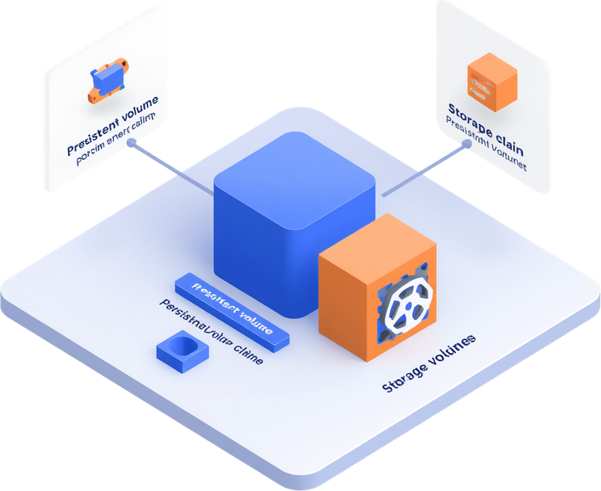
KUBERNETES STORAGE ARCHITECTURE
Kubernetes provides a robust storage architecture with key components:
• Persistent Volume (PV): Cluster-level storage resource provisioned by admins, independent of pod lifecycle
• Persistent Volume Claim (PVC): User request for storage that binds to available PVs based on size and access modes
• Storage Classes: Define different tiers of storage (SSD, HDD) with dynamic provisioning capabilities
• CSI Drivers: Container Storage Interface plugins that connect K8s to external storage systems
• Access Modes: ReadWriteOnce, ReadOnlyMany, ReadWriteMany

Slide 8
VOLUME TYPES OVERVIEW
emptyDir & hostPath
• emptyDir: Temporary storage tied to Pod lifecycle
• Created when Pod starts, deleted when Pod ends
• hostPath: Mounts host node filesystem path
• Data persists beyond Pod but node-specific
• Use cases: caching, logs, shared data
NFS & CSI Storage
• NFS enables shared storage across nodes
• Supports ReadWriteMany access mode
• CSI provides standardized storage interface
• Supports cloud providers (AWS EBS, Azure Disk)
• Production-ready persistent storage
ConfigMap & Secrets
• ConfigMap mounts configuration data as files
• Secrets store sensitive data like passwords & tokens
• Both mount as read-only volumes
• Automatically updated when source changes
• Ideal for application configuration

Slide 9
NFS & CSI STORAGE
NFS (Network File System) enables shared storage across multiple pods and nodes. It provides a centralized storage solution where data persists independently of pod lifecycle. NFS volumes can be mounted simultaneously by multiple pods, making it ideal for applications requiring shared access to files across the cluster.
CSI (Container Storage Interface) is the standard for exposing storage systems to Kubernetes. It allows storage vendors to develop plugins independently of Kubernetes core code. CSI drivers enable dynamic provisioning, snapshots, and cloning capabilities, providing enterprise-grade storage features for production workloads.

Slide 10
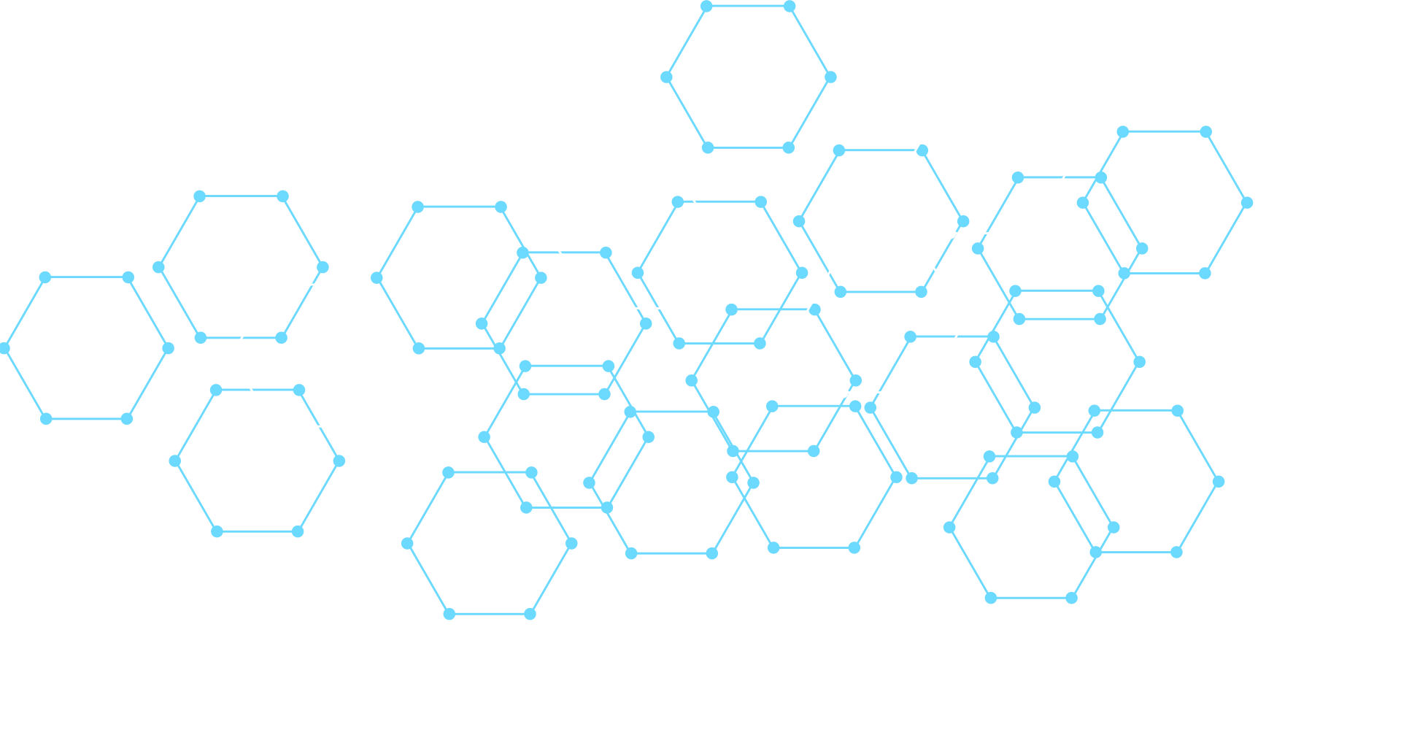
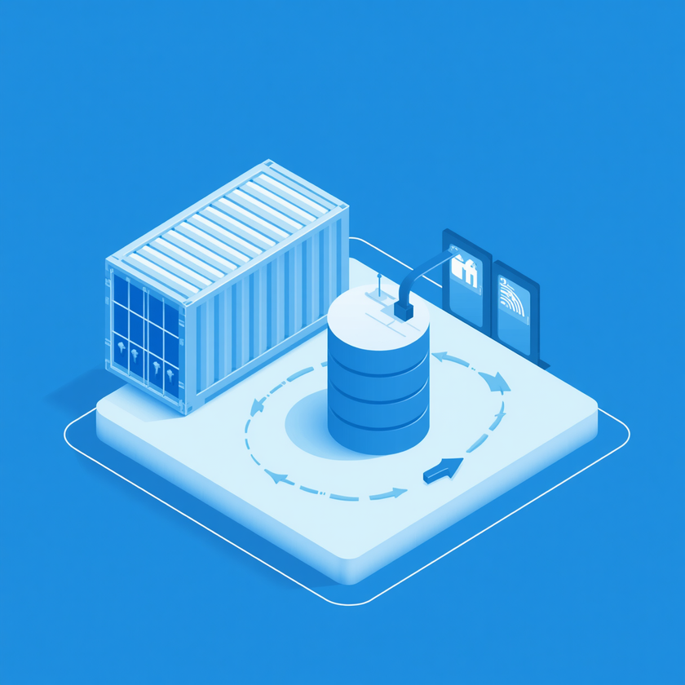
WHAT IS A VOLUME?
A Volume is a persistent storage abstraction in Kubernetes that outlives the container lifecycle.
• Directory accessible to containers in a Pod
• Data persists across container restarts
• Decouples storage from container lifecycle
• Can be backed by various storage types (local, network, cloud)
• Mounted at specified paths within containers
• Enables data sharing between containers in the same Pod

Slide 11

EMPTYDIR VOLUME
Created when a Pod is assigned to a Node and exists as long as the Pod runs on that node. Initially empty, all containers in the Pod can read/write the same files. Data is deleted permanently when Pod is removed.
Use Cases: Scratch space for sorting algorithms, checkpointing long computations, holding files that a content-manager container fetches while a webserver container serves the data.
Key Limitation: Data does NOT persist beyond Pod lifecycle. If the Pod crashes, restarts, or is rescheduled to another node, all data in emptyDir is lost permanently.

Slide 12



CONFIGMAP & SECRETS
ConfigMap: Inject configuration data as environment variables or files into pods. Decouples configuration from container images for portability.
Secrets: Store sensitive data like passwords, tokens, and keys. Base64 encoded and can be mounted as files or environment variables.
Best Practice: Never hardcode credentials in images. Use ConfigMaps for non-sensitive config and Secrets for sensitive data with RBAC controls.

Slide 13
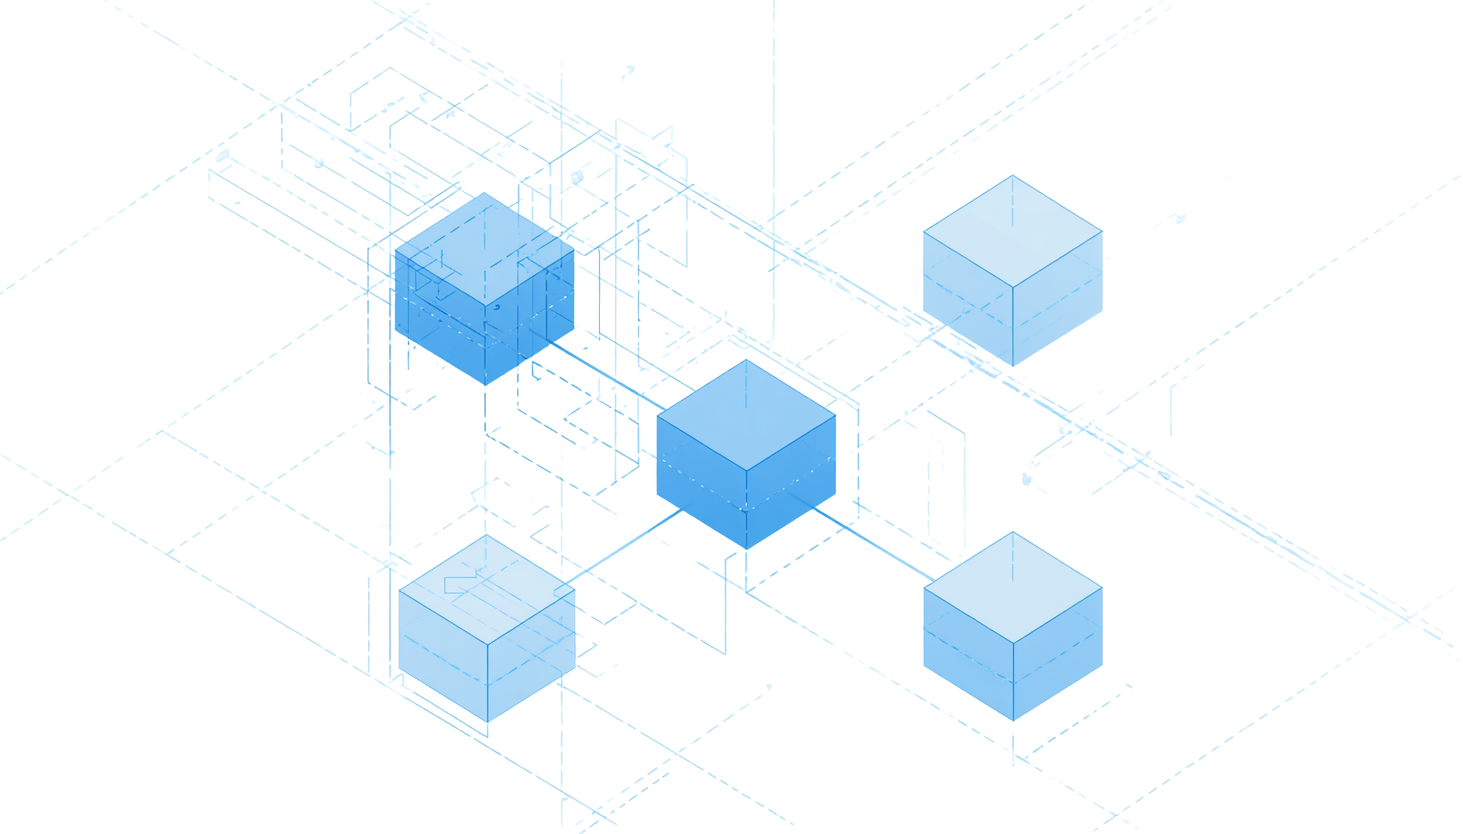
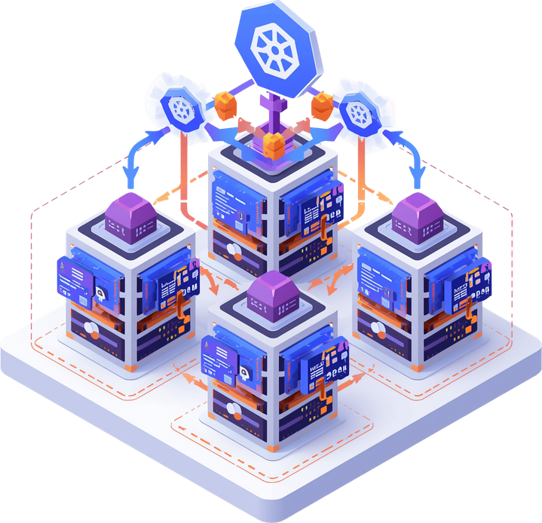
DEMO ARCHITECTURE
Our demo environment consists of three key scenarios to illustrate Kubernetes storage concepts:
• emptyDir Demo: Two pods sharing temporary storage, demonstrating data loss on pod restart
• hostPath Demo: Pod accessing node filesystem, showing node dependency limitations
• NFS Demo: Multiple pods across nodes sharing persistent NFS storage
Each scenario uses a simple web application writing and reading data to demonstrate storage behavior in real-time.

Slide 14

DEMO RESULTS: EMPTYDIR
Data Loss on Pod Restart: When the pod was deleted and recreated, all data stored in emptyDir was completely lost. This demonstrates that emptyDir storage is ephemeral and tied to the pod lifecycle, not the container lifecycle.
Inconsistency Across Replicas: When scaling to multiple replicas, each pod received its own separate emptyDir volume. Data written by one pod was not visible to other pods, causing data inconsistency in distributed applications.

Slide 15
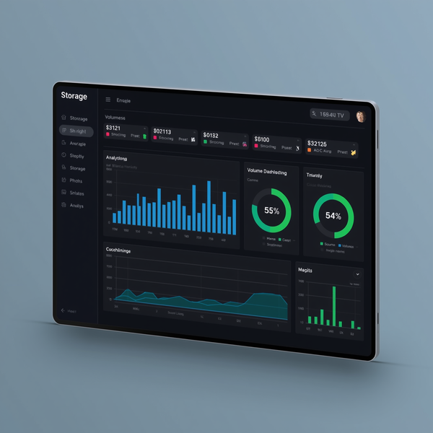

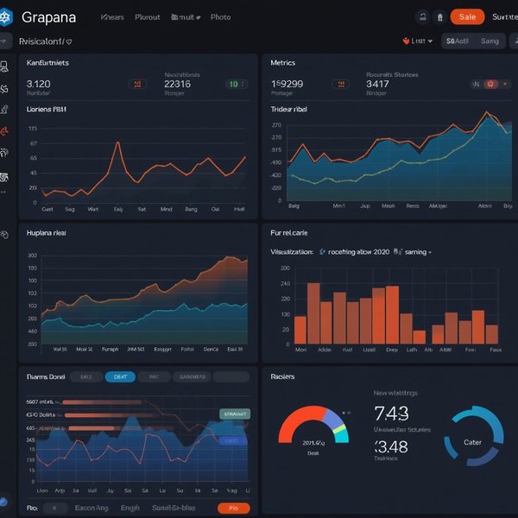
BEST PRACTICES
Choose the Right Volume Type: Select emptyDir for temporary data, hostPath for node-specific needs, NFS for shared storage across pods, and CSI for cloud-native persistent storage. Match volume type to your workload requirements.
Use PVC for Portability: Always use PersistentVolumeClaims (PVC) with StorageClasses instead of directly referencing volumes. This ensures your applications remain portable across different Kubernetes clusters and cloud providers.
Monitor with Prometheus & Grafana: Implement comprehensive storage monitoring using Prometheus metrics and Grafana dashboards. Track volume capacity, IOPS, latency, and usage trends to prevent storage-related outages.

Slide 16
THANK YOU!
Questions & Answers
Let's discuss your storage challenges

